Slide 1
Directed study review

Slide 2
Social and visual storytelling
MED7334 Narrative

Slide 3
By next week you should be able to:
Explain how writing for social media is different to other platforms and media
Write for social media using a range of techniques and structures
Explain how to optimise stories for different platforms

Slide 4

Orientation:
where are we?
..

Slide 5
The assignment elements…
Item 1 (main piece) 500-800 words | OR: 3-10 minutes maximum | 2-10 social media items
Edited interview feature | Edited video interview hosted on YouTube, including title and description | Tweet (X post) or thread
Edited multi-interview feature | Edited video package hosted on YouTube including title and description | Instagram update, carousel or Reel
Profile feature based on one or more interviews | Edited audio package hosted on audio platform including title, image and description | Other social update: Facebook, LinkedIn, etc.
News report based on one or more interviews | Edited podcast or radio interview hosted online including title, image and description | Series of live tweets
Explainer drawing on one or more interviews |  | Short video embedded in a Facebook or Twitter update
Listicle based on one or more interviews |  | Instagram/Snapchat Story (minimum 8 slides)
Scrollytell based on one or more interviews |  | TikTok video
Email newsletter featuring an interview element |  | Audiogram embedded in a Facebook/Twitter/Instagram update
Other formats can be done with agreement from module leader |  | Livestream including title and description

Slide 6
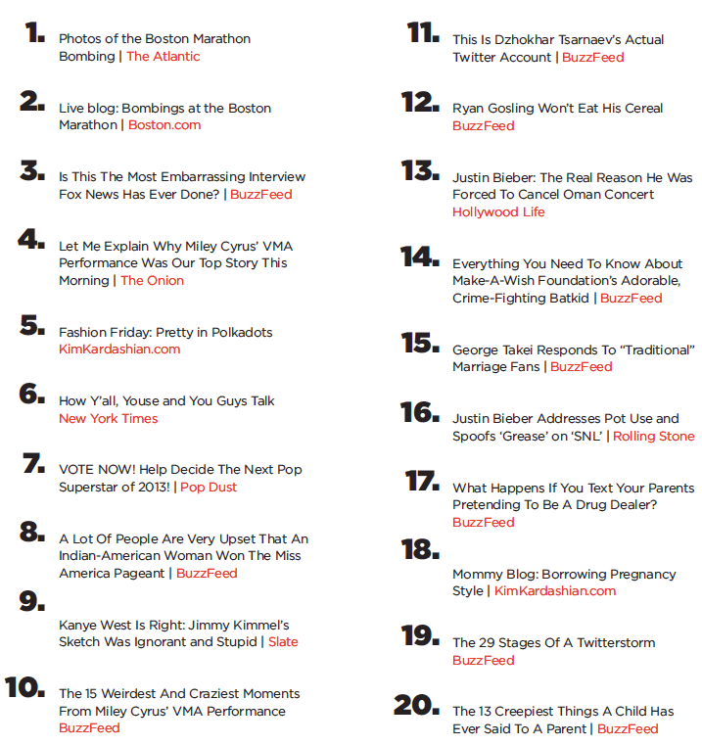
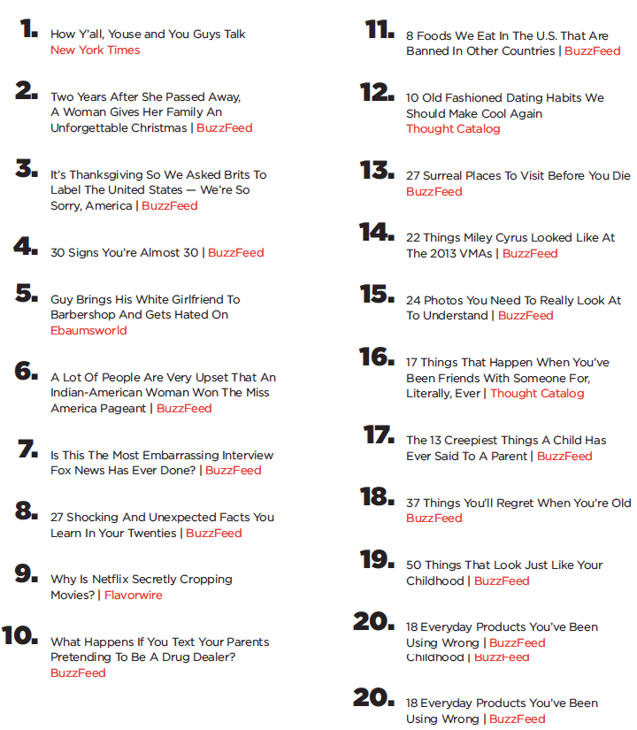
Different platforms = different
audiences, algorithms & expectations
http://www.theatlantic.com/business/archive/2014/02/the-facebook-effect-on-the-news/283746/

Slide 7
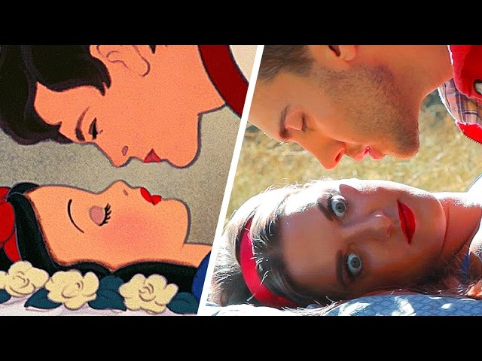
“Facebook is a lot more about personal identity and interacting with friends, while YouTube is a lot more about consuming video, so they have pretty different audiences.”
http://digiday.com/publishers/inside-buzzfeed-video/

Slide 8
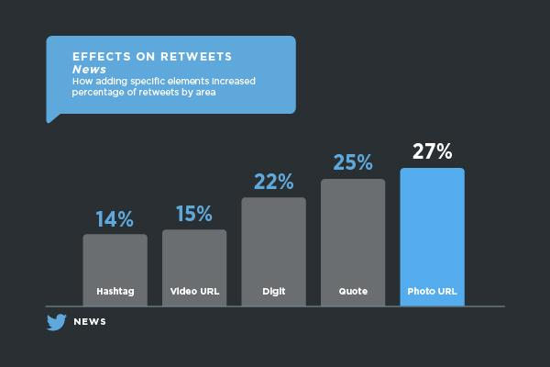
Complication:
what works?
..

Slide 9
https://media.twitter.com/best-practice/news-the-impact-of-tweeting-with-photos-videos-hashtags-and-links

Slide 10
Compared to text:
Images: 3x more engagement
GIFs: 6x more engagement
Video: 9x more engagement
https://www.socialmediatoday.com/social-business/images-gifs-or-video-which-generates-most-response-twitter
https://blog.twitter.com/en_gb/a/en-gb/2016/5-reasons-why-you-should-use-video-on-twitter.html

Slide 11
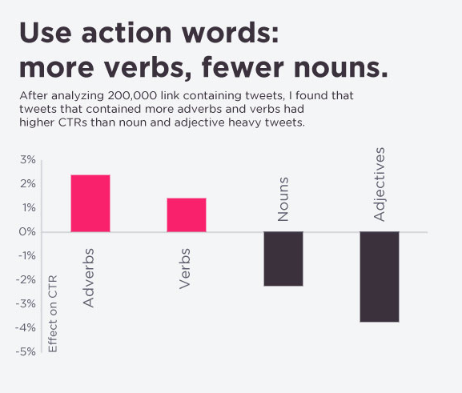
http://blog.bufferapp.com/a-scientific-guide-to-writing-great-headlines-on-twitter-facebook-and-your-blog

Slide 12
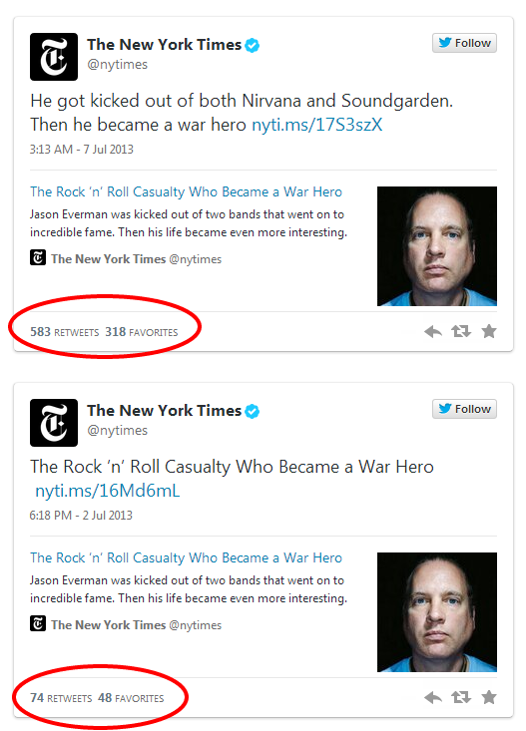
“A small amount of editorial effort was the difference between one of the best tweets of the year and a headline from print that was less effective in the context of social media”
http://www.niemanlab.org/2014/01/if-a-tweet-worked-once-send-it-again-and-other-lessons-from-the-new-york-times-social-media-desk/

Slide 13
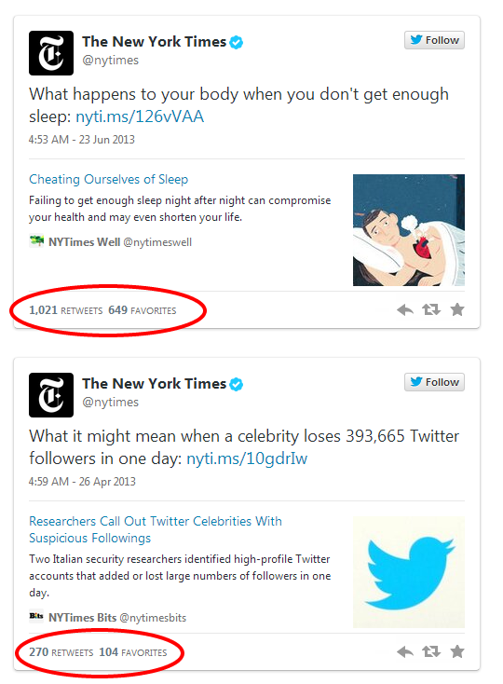
“We don’t always need to try so hard to write an unforgettable tweet, or one that tempts the reader too much. Clarity and straightforwardness around interesting subject matter are ultimately rewarded by substantial reader interest.”
http://www.niemanlab.org/2014/01/if-a-tweet-worked-once-send-it-again-and-other-lessons-from-the-new-york-times-social-media-desk/

Slide 14
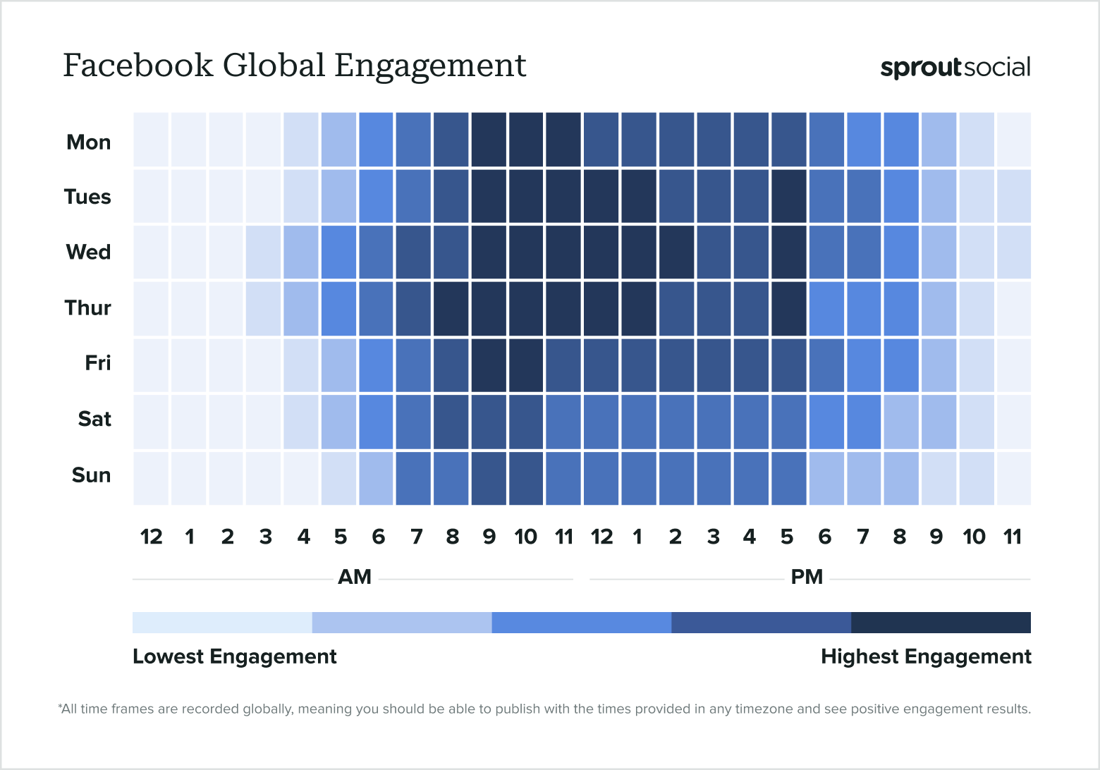
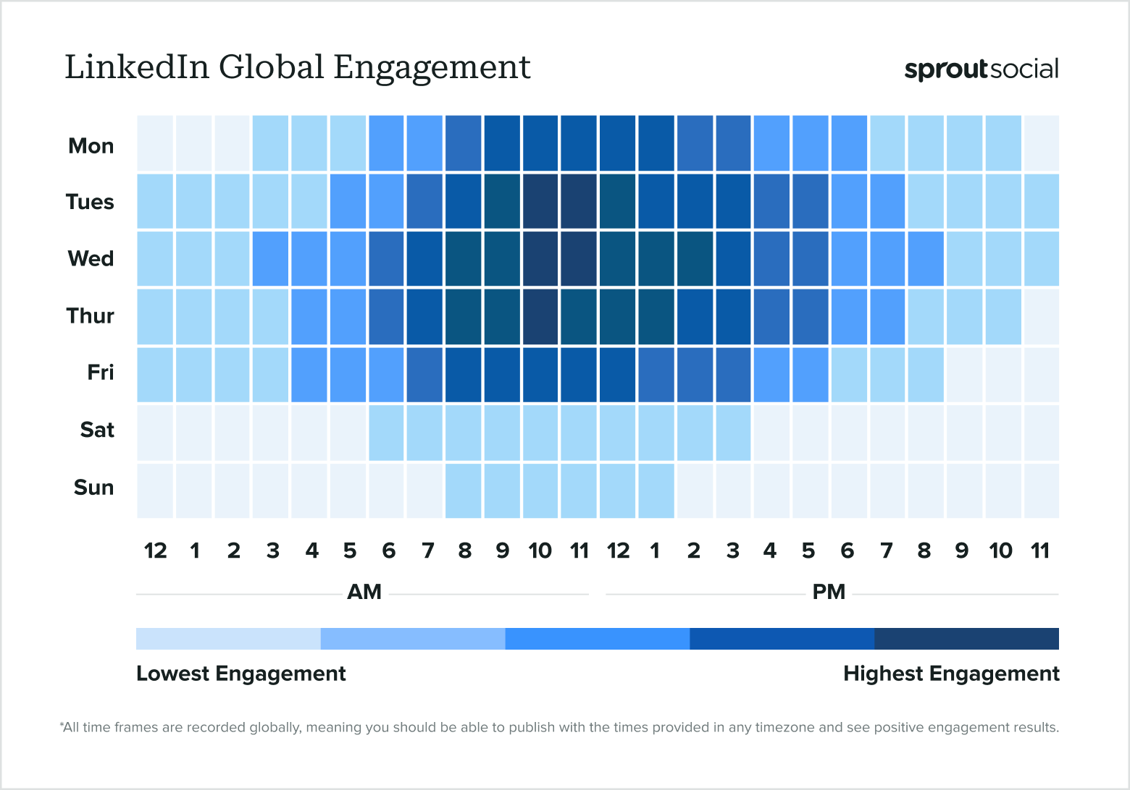
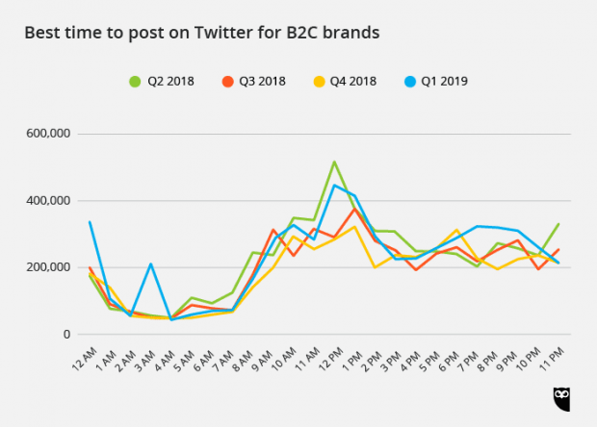
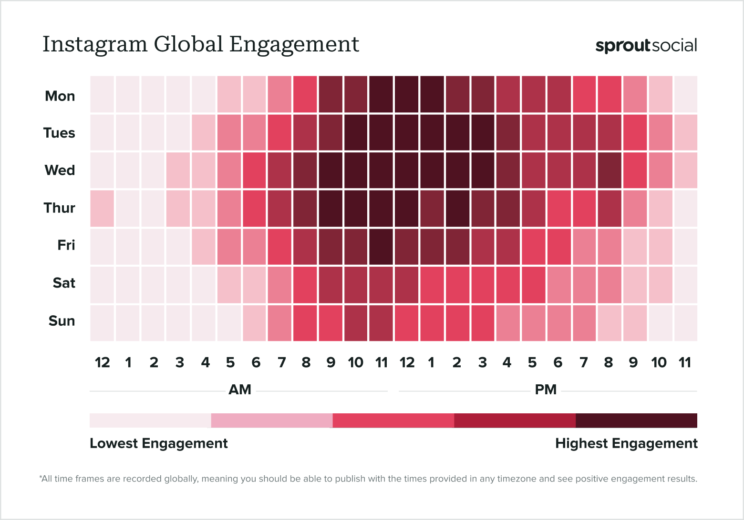
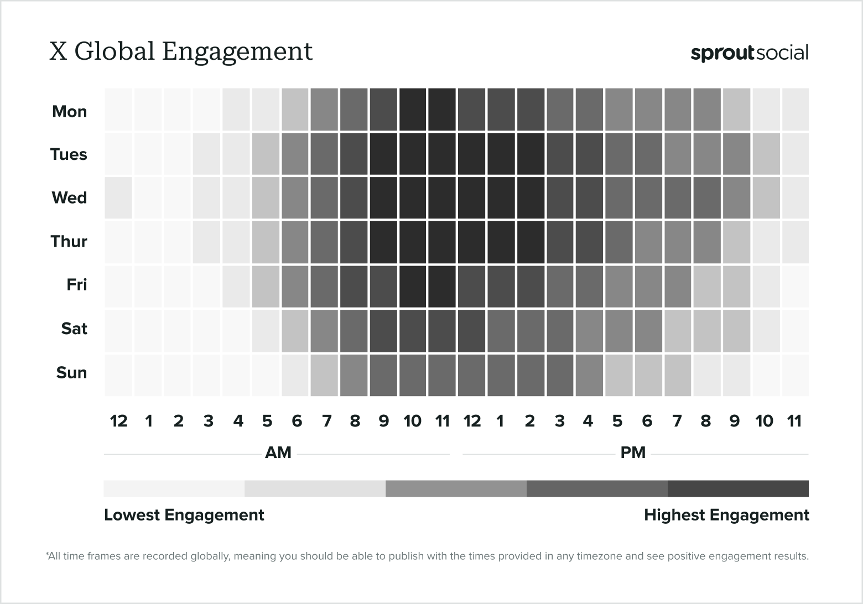
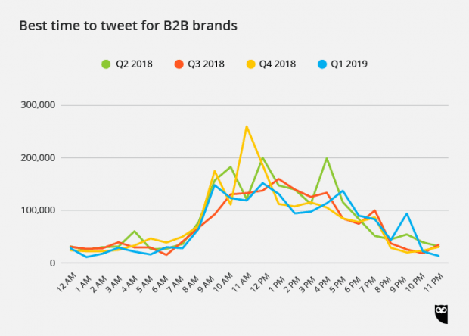
Consider timing
https://sproutsocial.com/insights/best-times-to-post-on-social-media/
https://adespresso.com/blog/best-time-to-post-on-twitter/

Slide 15
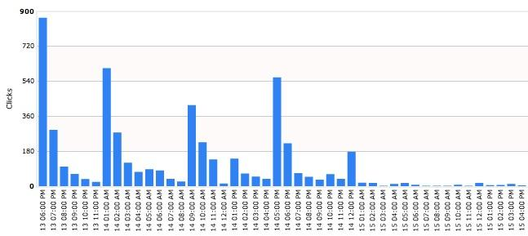
“In the case of repeating a tweet four times in thirty-two hours,
there was a big spike for the first tweet, but the next three still yielded very good results.”
Consider posting multiple times
https://www.americanexpress.com/us/small-business/openforum/articles/how-to-drive-traffic-with-repeat-tweets-1/
http://www.niemanlab.org/2014/01/if-a-tweet-worked-once-send-it-again-and-other-lessons-from-the-new-york-times-social-media-desk/
http://www.niemanlab.org/2011/03/tweet-late-and-e-mail-early-using-data-to-develop-strategy

Slide 16
9 things to check:
Does it have image/video/GIF/emojis?
Does it NOT read like a headline?
Is there a CTA (Call To Action)?
Has it considered hashtags?
Does it @ name subjects?
Does it have beginning and end?
Can it use quotes or numbers?
Is it timed appropriately?
Are you testing different versions?

Slide 17
What types of
content works?
Social media optimisation

Slide 18
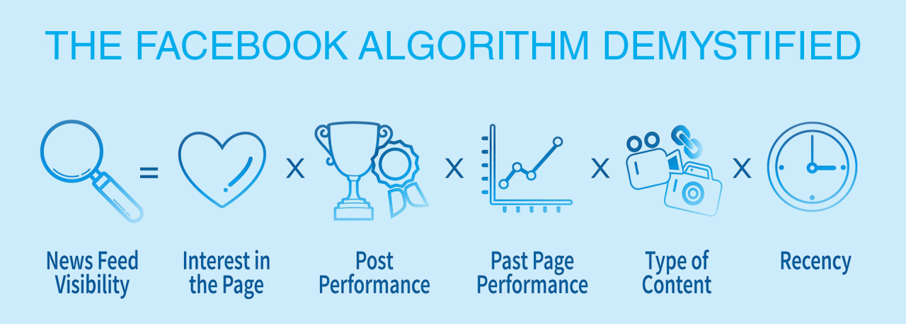
Ly Kha Ngo. Decoding Facebook Algorithms: Strategies for 2024 Success, January 11, 2024

Slide 19
Facebook:
Invite/stimulate engagement
Build a history of engagement
Subject matter matches user’s past consumption
Variety: algorithm likes to mix media types
Time spent on post: is your content likely to keep them watching/reading (be compelling and well edited, not long)
Read: Macready, Hannah. 2024 Facebook Algorithm: Tip + Secrets Revealed, Hootsuite, January 11, 2024

Slide 20
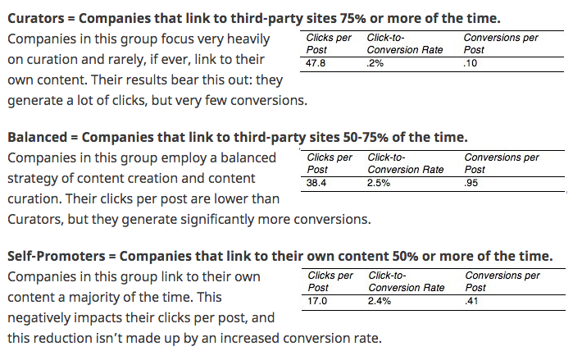
Balanced posters get “20% fewer clicks per post than Curators, but their conversion rate is 10X higher. I’ll take that trade any day.”
http://www.convinceandconvert.com/social-media-measurement/new-research-finds-the-curation-vs-creation-sweet-spot/

Slide 21
LinkedIn engagement:
A like is worth 1 point
Comment: 15
Instant repost: 10
'Save': 8
'See more': 5 points
Van Der Blom, Algorithm Insights 2024

Slide 22
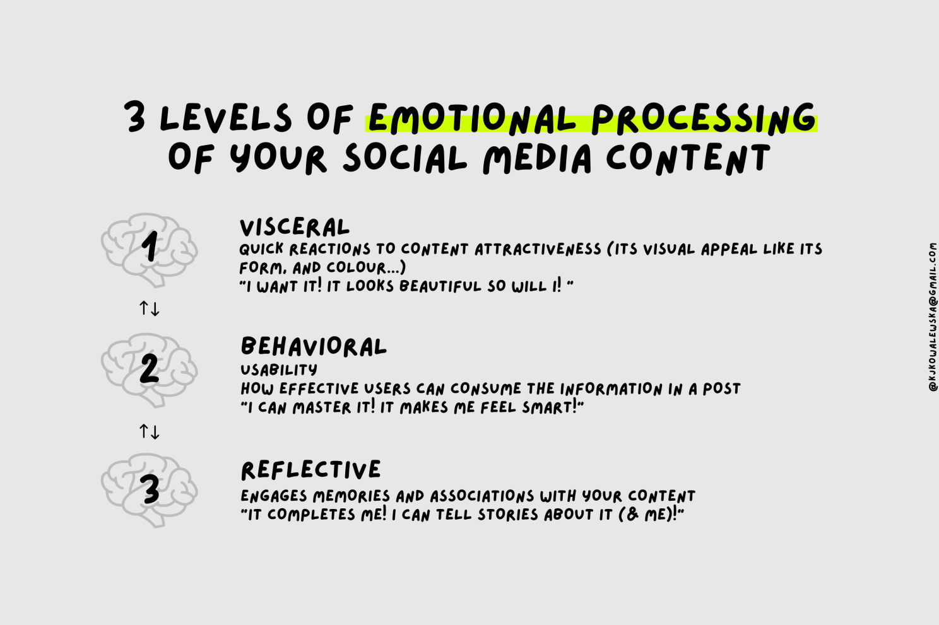
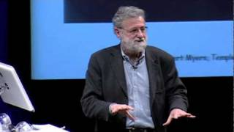
Kowalewska, Katarzyna. Use the power of emotions to improve how your social media content performs, LinkedIn, June 28, 2023
(based on Norman, Don (2005) Emotional Design: Why We Love (or Hate) Everyday Things

Slide 23
Pick and mix:
V1: Use visually appealing, high-quality images
V2: Incorporate a human element into your content strategy.
B1: Cater to new users: Answer questions
B2: Engage existing followers: keep them engaged and excited
R1: Ignite nostalgia
R2: Embrace shared values
Kowalewska, Katarzyna. Use the power of emotions to improve how your social media content performs, LinkedIn, June 28, 2023
(based on Norman, Don (2005) Emotional Design: Why We Love (or Hate) Everyday Things

Slide 24
An opportunity for learning
Watch the video in full, then:
“I used Kowalewska’s tips (Kowalewska 2023) by doing ___.”
“I could have done ____ to improve the updates (Kowalewska 2023).”
Kowalewska, Katarzyna. Use the power of emotions to improve how your social media content performs, LinkedIn, June 28, 2023
(based on Norman, Don (2005) Emotional Design: Why We Love (or Hate) Everyday Things

Slide 25
What structures work?
..

Slide 26
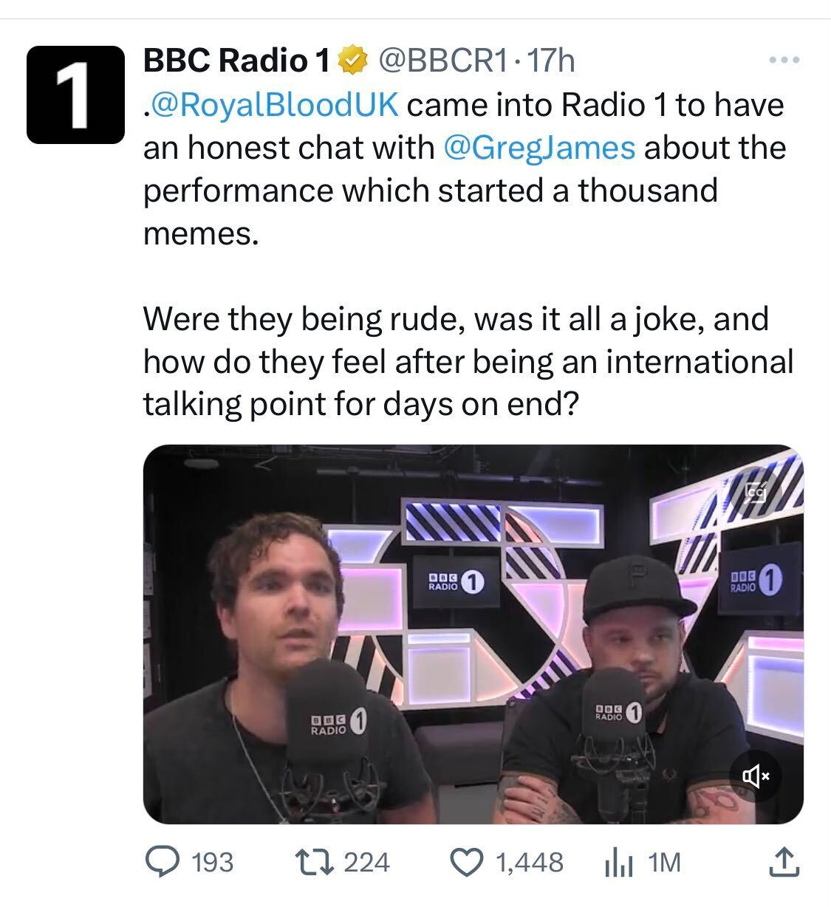
Orientation (who/where)
and abstract (story in a nutshell)
Would this be better reversed?
Complication (raise a question)
Evaluation, result, coda
https://twitter.com/BBCR1/status/1665709333009813506

Slide 27
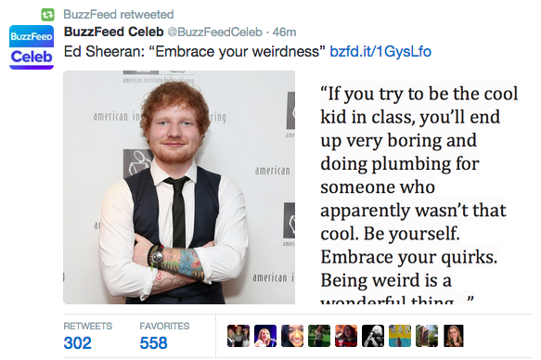
Abstract and orientation (who)
Complication
Evaluation
result/coda
https://twitter.com/BuzzFeedCeleb/status/608637481693671424

Slide 28
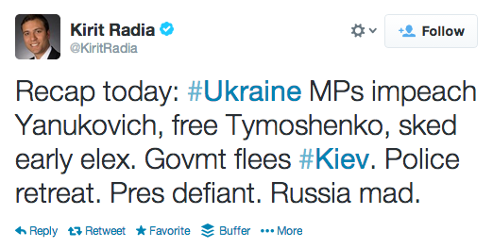
Linear chronology

Slide 29
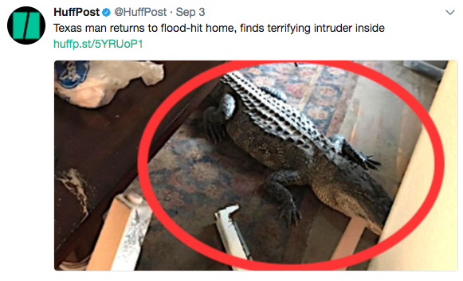
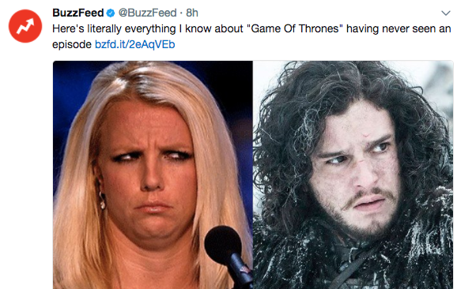
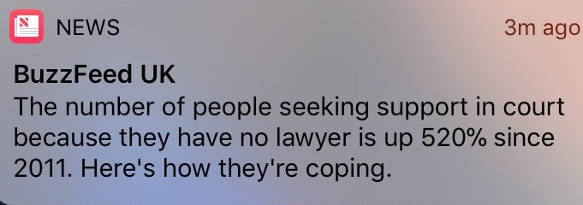
Intro and twist

Slide 30
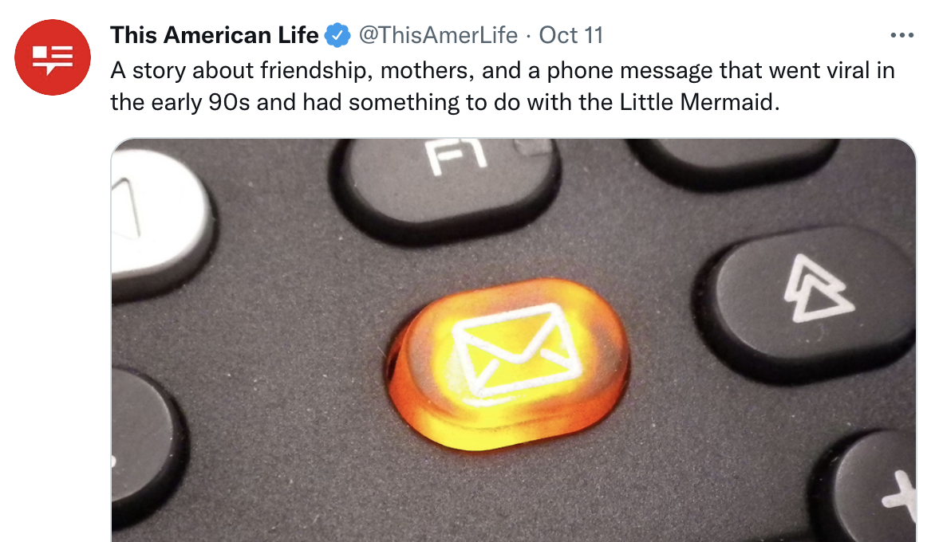
Intro and twist

Slide 31
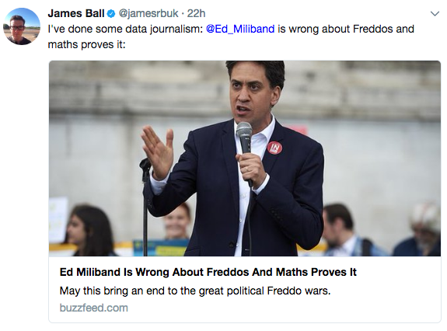
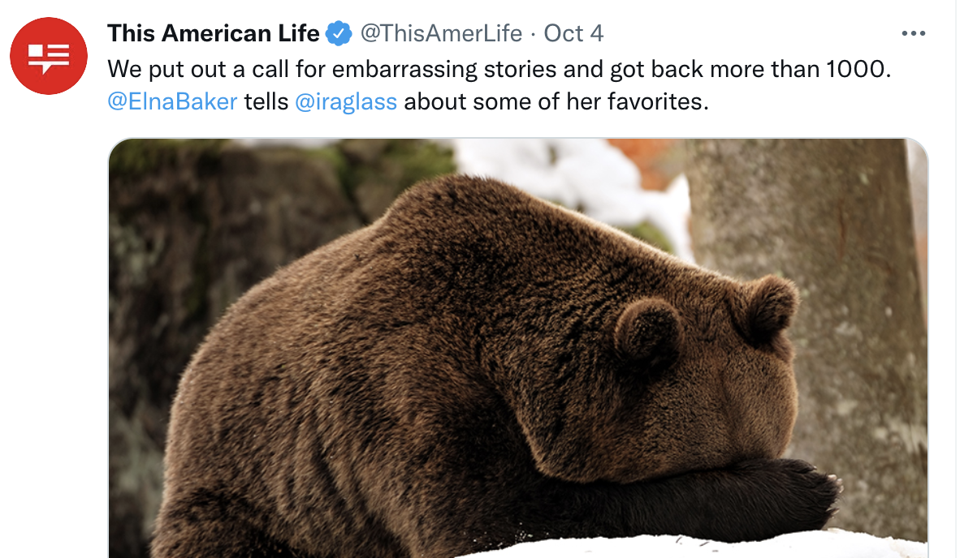
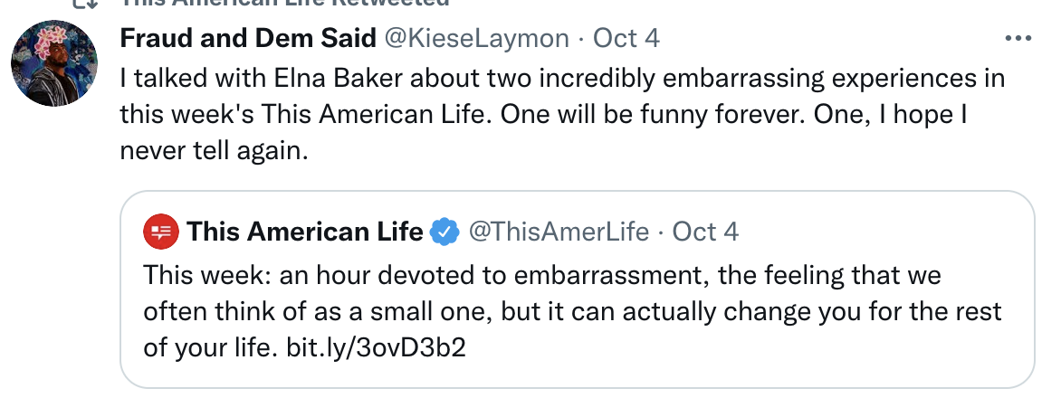
Action, Hook, and Resolution!

Slide 32
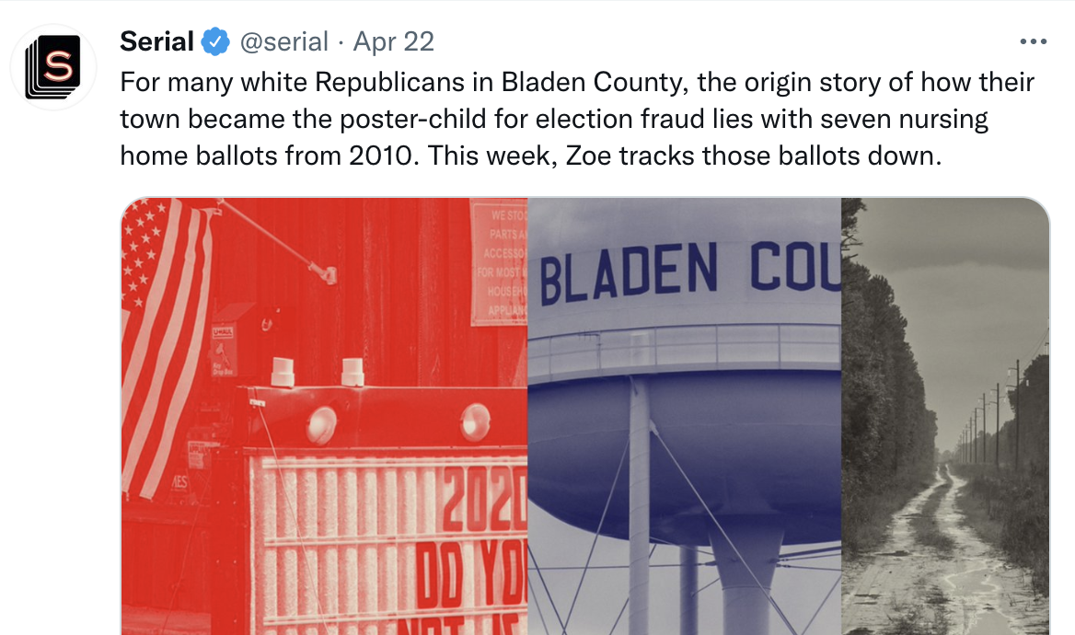
Standfirst/cue-style

Slide 33
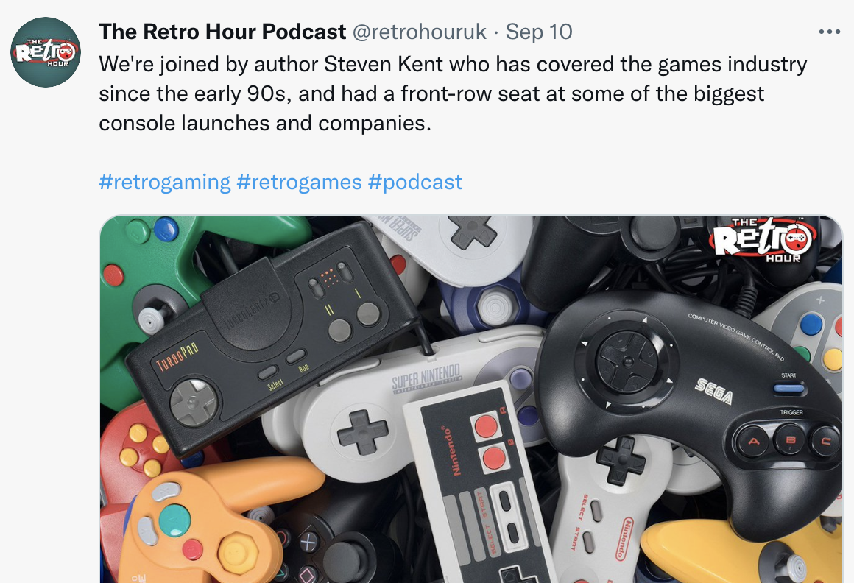
Does this work? Could it be better?

Slide 34
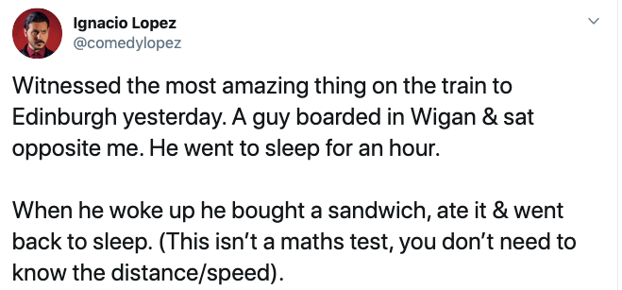
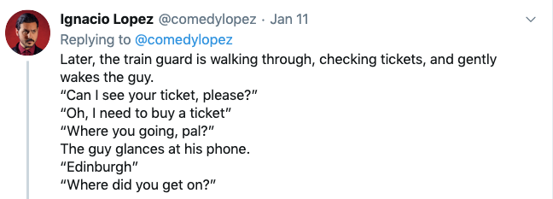
The thread (sequence/chapters)

Slide 35
Turn a story* into a tweet/update
Does it have a beginning - and end?
Genre conventions: hashtags, @names, emoji
DO NOT PROMOTE - TELL THE STORY
Use the checklist…
*Can be a documentary, interview, film, news story, listicle, etc. Tip: use an IMDB plot summary for a favourite film .

Slide 36
9 things to check (again):
Does it have image/video/GIF/emojis?
Does it NOT read like a headline?
Is there a CTA (Call To Action)?
Has it considered hashtags?
Does it @ name subjects?
Does it have beginning and end?
Can it use quotes or numbers?
Is it timed appropriately?
Are you testing different versions?

Slide 37
The result...

Slide 38
This is what you should know.
Tell a story, don’t promote. Have a beginning, middle and end — make every word count
Optimise relationships and reactions
Be visual: emoji, gifs, memes, photos, graphics, video — even from text/audio

Slide 39
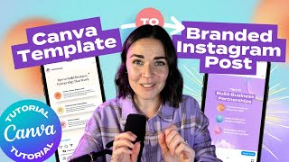
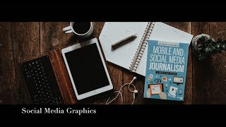
Independent study:
Read: Writing for social media
OR Social media: enhancing resilience
OR: Watch a video about social media graphics 👇
OR: If Don Draper Tweeted - copywriting formulas for writing online

Slide 40
Independent study task:
AFTER reading/watching: apply the techniques to post updates about your story, work and life! Be creative.
Aim for 10-20 updates across different platforms.
Look for other examples in your field: what conventions do they use that you should adhere to?
Make notes for your evaluation: connect to reading/watching

Slide 41
Questions?

